Slide 1
Algorithm
An “algorithm" is a formally defined procedure for performing some calculation. It provides a blueprint to write a program to solve a particular problem.
It is considered to be an effective procedure for solving a problem in finite number of steps. That is, a well-defined algorithm always provides an answer and is guaranteed to terminate.
Algorithms are mainly used to achieve software re-use. Once we have an idea or a blueprint of a solution, we can implement it in any high level language like C, C++, Java, so on and so forth.

Slide 2
Time and Space Complexity of Algorithm
To analyze an algorithm means determining the amount of resources (such as time and storage) needed to execute it.
Efficiency or complexity of an algorithm is stated in terms of time complexity and space complexity.
Time complexity of an algorithm is basically the running time of the program as a function of the input size.
Similarly, space complexity of an algorithm is the amount of computer memory required during the program execution, as a function of the input size.

Slide 3
Time and Space Complexity of Algorithm
Time complexity of an algorithm depends on the number of instructions executed. This number is primarily dependent on the size of the program's input and the algorithm used.
The space needed by a program depends on:
Fixed part includes space needed for storing instructions, constants, variables, and structured variables.
Variable part includes space needed for recursion stack, and for structured variables that are allocated space dynamically during the run-time of the program.

Slide 4
Calculating Algorithm Efficiency
The efficiency of an algorithm is expressed in terms of the number of elements that has to be processed. So, if n is the number of elements, then the efficiency can be stated as Efficiency = f(n).
If a function is linear (without any loops or recursions), the efficiency of that algorithm or the running time of that algorithm can be given as the number of instructions it contains.
If an algorithm contains certain loops or recursive functions then its efficiency may vary depending on the number of loops and the running time of each loop in the algorithm.

Slide 5
Calculating Algorithm Efficiency
Linear loops
for(i=0;i<100;i++)
statement block
f(n) = (n)
Logarithmic Loops
for(i=1;i<1000;i*=2) for(i=1000;i>=1;i/=2)
statement block; statement block;
f(n) = log n
Nested Loops
Linear logarithmic
for(i=0;i<10;i++)
for(j=1; j<10;j*=2)
statement block;
f(n)= n log n

Slide 6
Big O Notation
Big-O notation, where the "O" stands for "order of", is concerned with what happens for very large values of n.
For example, if a sorting algorithm performs n² operations to sort just n elements, then that algorithm would be described as an O(n²) algorithm.
When expressing complexity using Big O notation, constant multipliers are ignored. So a O(4n) algorithm is equivalent to O(n), which is how it should be written.

Slide 7
Big O Notation
If f(n) and g(n) are functions defined on positive integer number n, then
f(n) = O(g(n))
That is, f of n is big O of g of n if and only if there exists positive constants c and n, such that
f (n) ≤ cg(n)
This means that for large amounts of data, f(n) will grow no more than a constant factor than g(n). Hence, g provides an upper bound.

Slide 8
Categories of Algorithms
Constant time algorithms have running time complexity given as O(1)
Linear time algorithms have running time complexity given as O(n)
Logarithmic time algorithms have running time complexity given as O(log n)
Polynomial time algorithms have running time complexity given as O(nk) where k>1
Exponential time algorithms have running time complexity given as O(2^{n})
n | O(1) | O(log n) | O(n) | O(n log n) | O(n²) | O(n³)
1 | 1 | 1 | 1 | 1 | 1 | 1
2 | 1 | 1 | 2 | 2 | 4 | 8
4 | 1 | 2 | 4 | 8 | 16 | 64
8 | 1 | 3 | 8 | 24 | 64 | 512
16 | 1 | 4 | 16 | 64 | 256 | 4,096

Slide 9
Omega Notation
Omega notation provides a tight lower bound for f(n). This means that the function can never do better than the specified value but it may do worse.
Ω notation is simply written as, f(n) ∈ Ω(g(n)), where n is the problem size and Ω(g(n)) = {h(n): ∃ positive constants c > 0, n₀ such that 0 ≤ cg(n) ≤ h(n), ∀ n ≥ n₀}.
Examples of functions in Ω(n²) include: n², n^{2.9}, n³ + n, 540n² + 10
Examples of functions not in Ω(n³) include: n, n^{2.9}, n²

Slide 10
Theta Notation
Theta notation provides an asymptotically tight bound for f(n).
Θ notation is simply written as, f(n) ∈ Θ(g(n)), where n is the problem size and Θ(g(n)) = {h(n): ∃ positive constants c₁, c₂ and n₀ such that 0 ≤ c₁g(n) ≤ h(n) ≤ c₂g(n), ∀ n ≥ n₀}.
Hence, we can say that Θ(g(n)) comprises a set of all the functions h(n) that are between c1g(n) and c2g(n) for all values of n ≥ n₀.
To summarize,
The best case in Θ notation is not used.

Slide 11
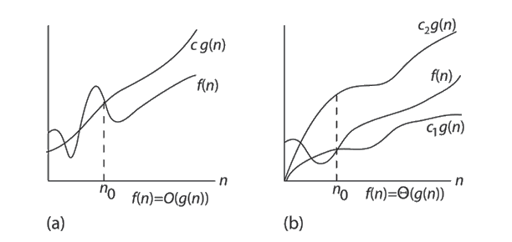
Mostly used notation for cases-
Best case - omega
Worst case - big O
Average case - theta

